Slide 1
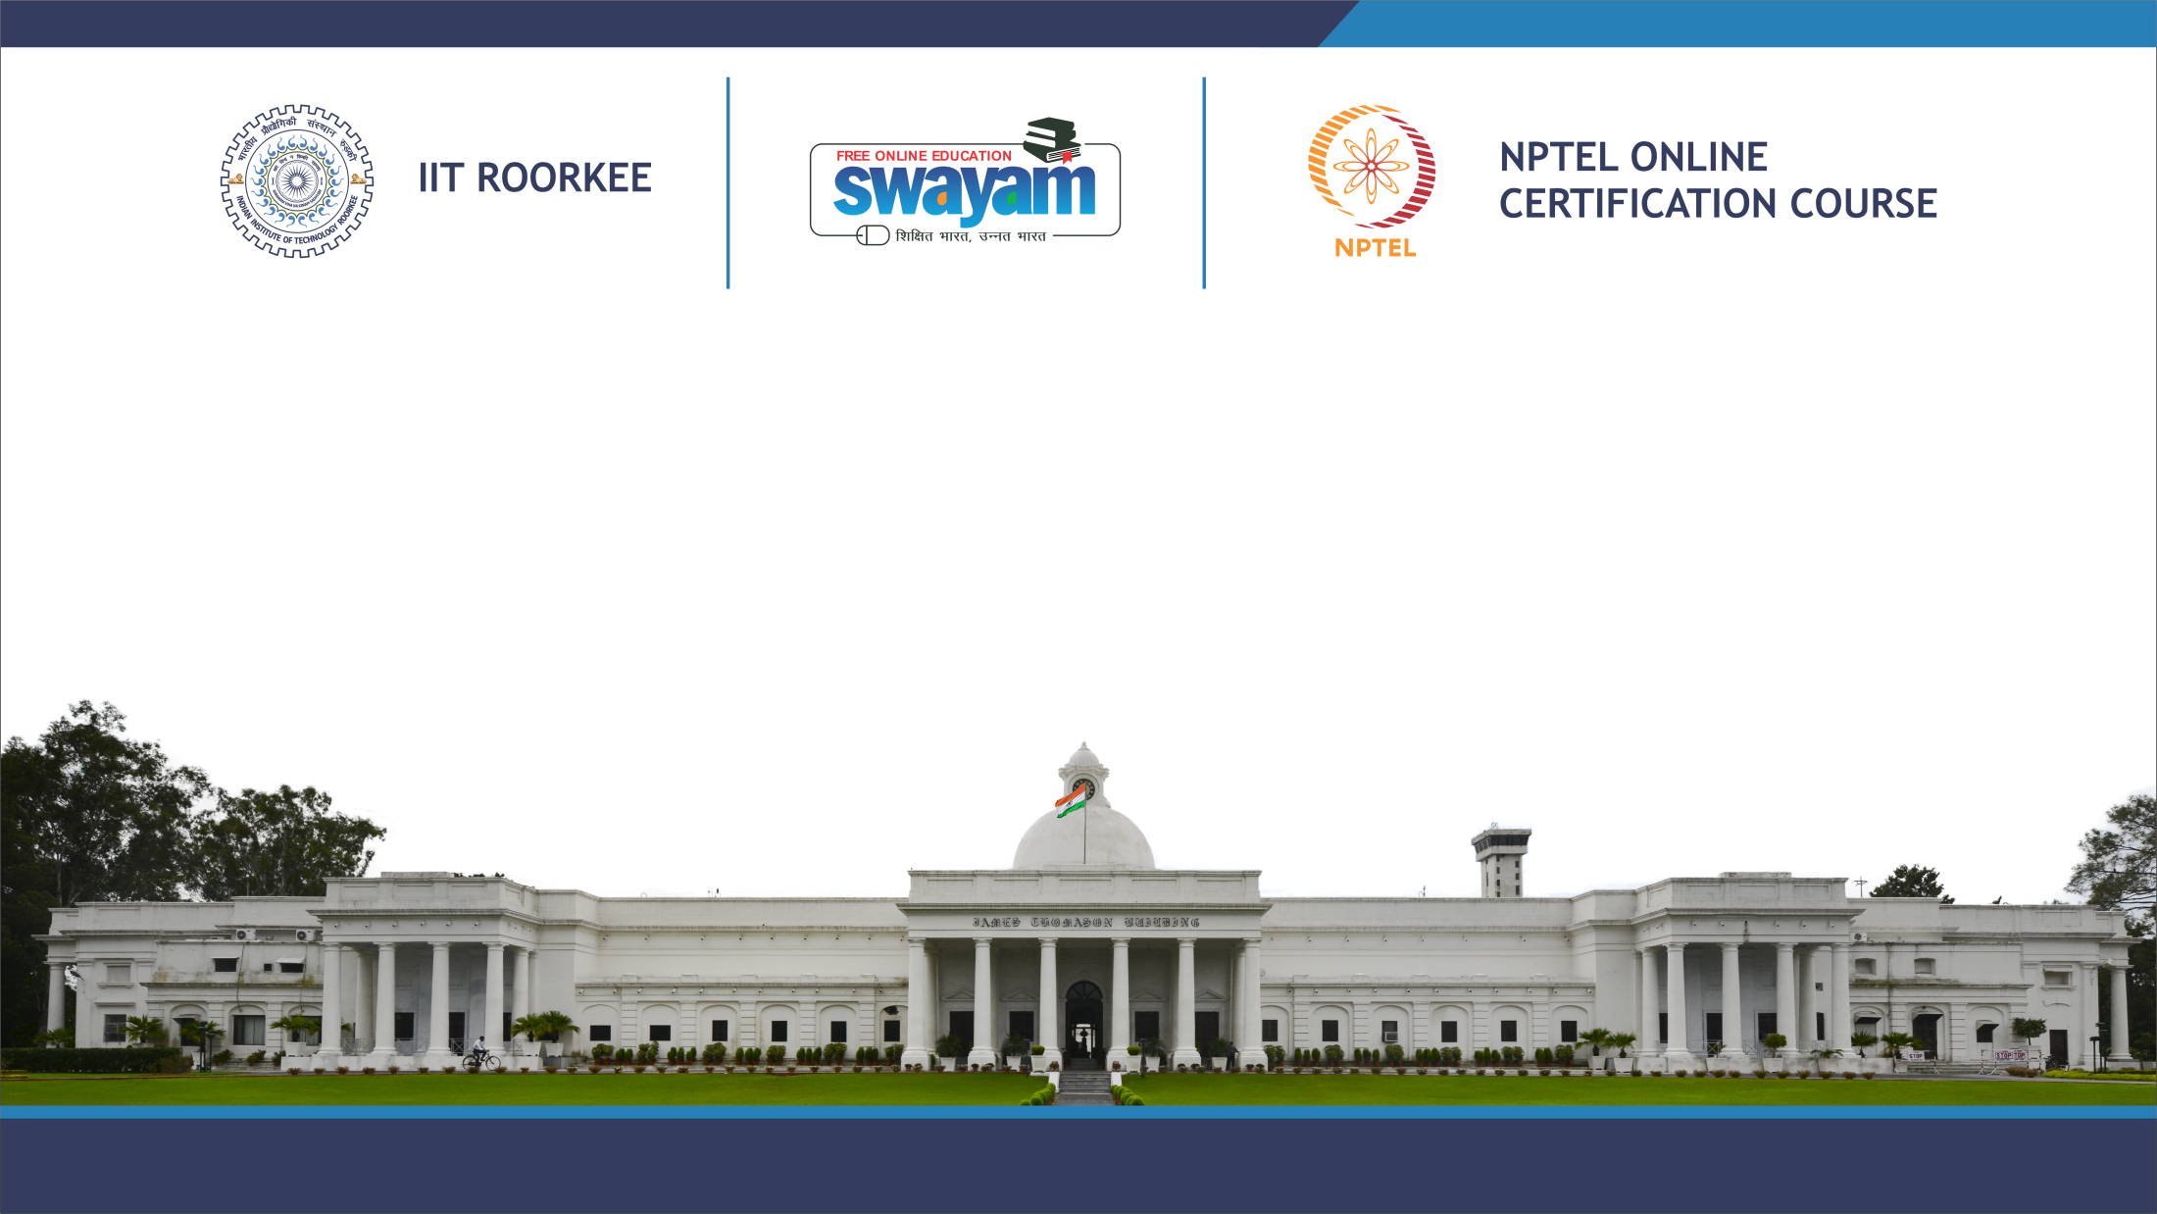
Public Speaking
Lecture 24: Chronemics
Prof. Binod Mishra
DEPARTMENT OF HUMANITIES AND SOCIAL SCIENCES

Slide 2
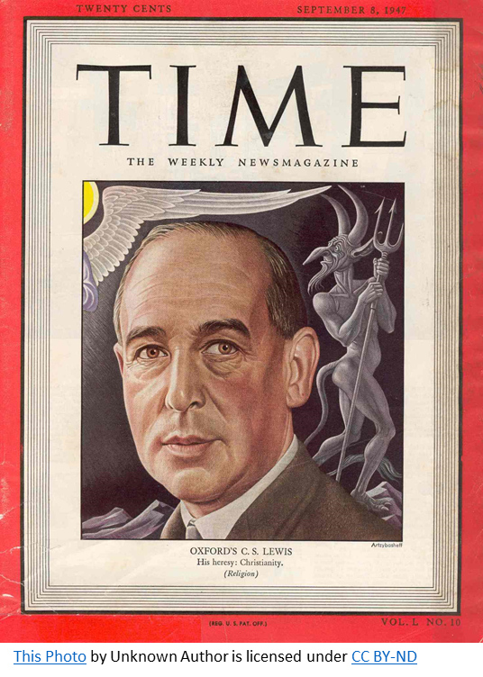
“For the Present is the point at which time touches the eternity” - C.S. Lewis

Slide 3
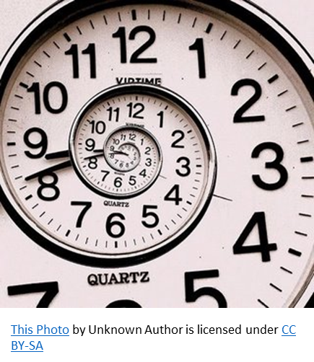
Introduction
Study of time in relation to human communication.
The term was coined by Thomas Bruneau in the year 1979.
“It is not space that is the hidden dimension of human communication, but it is time that is hidden and is a major aspect of all areas of semiotic or nonverbal communication.” (Bruneau 91)
Time,
Timing 3 Essentials of Chronemics
Tempo

Slide 4
Time Talks
The time at which communication occurs suggests the nature and importance of communication. Example: An early morning telephone call or a late-night call might signify urgency.
In Western culture, advance notice is rendered for the scheduling of events.
Edward Hall termed this particular preparatory duration before the main event as “lead time”.
Western culture perceives time as “a road to the future” while for many other native cultures “time is all that is present”.

Slide 5
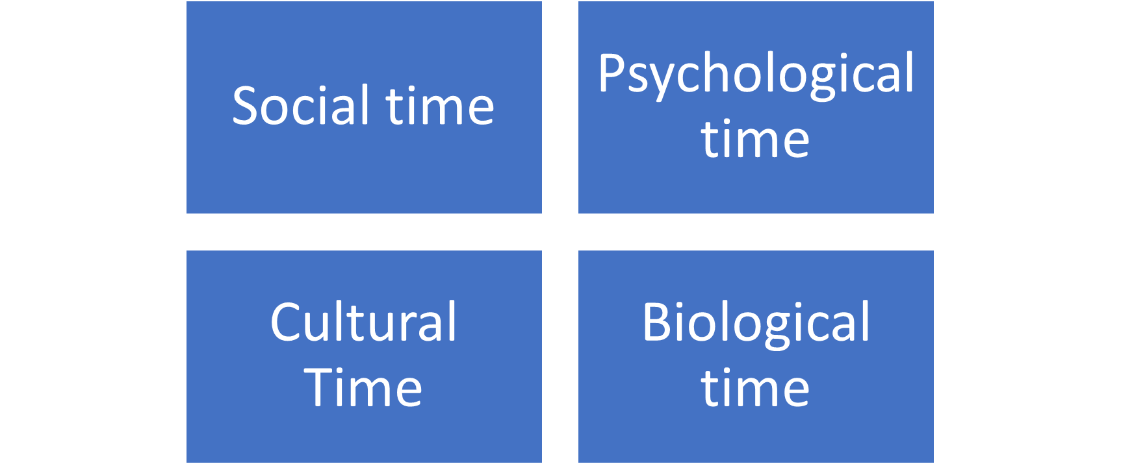
Types of Time

Slide 6
Contd…
Social time: It refers to how a particular society as a group perceives, understands and equips time.
Psychological time: It refers to an individual’s own temporal experiences in relation to the duration, pace and succession of an event.
Biological time: It includes our bodily understanding of time to carry out our diurnals at regular intervals.
Cultural time: A cultural outlook towards time orientation in terms of the culture’s preference towards its past, present and future.

Slide 7
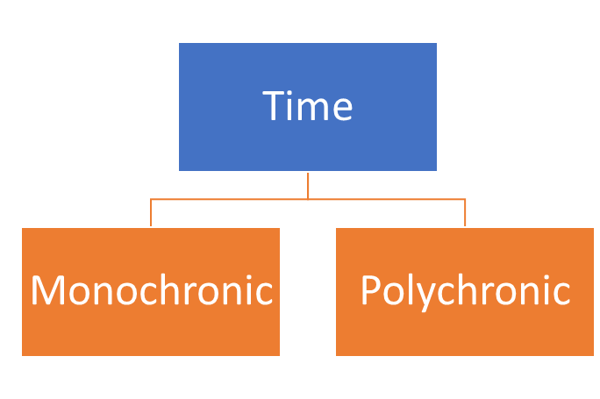
Time Perceptions
•Time as a concept is perceived differently in various parts of the world.
•It varies on the basis of culture, nation, ethnicity and traditional customs.
•In general, time is categorized into largely two categories:
i. Monochronic
ii. Polychronic

Slide 8
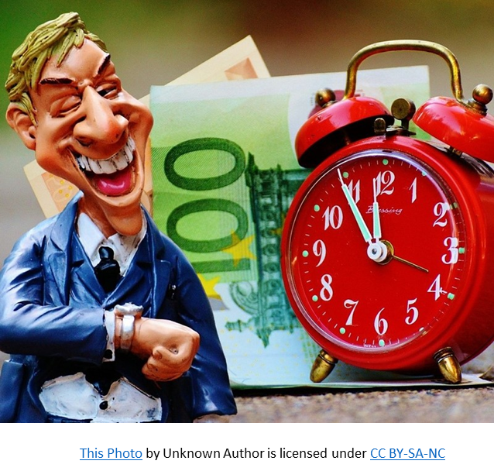
Monochronic Time
• Individualistic. Low-context cultures.
• “One thing at a time” is the mantra.
• Schedules are kept tight and respected.
• Punctuality is upheld.
• Precision is appreciated.
• M-time is observed in German, North American and North European cultures.

Slide 9
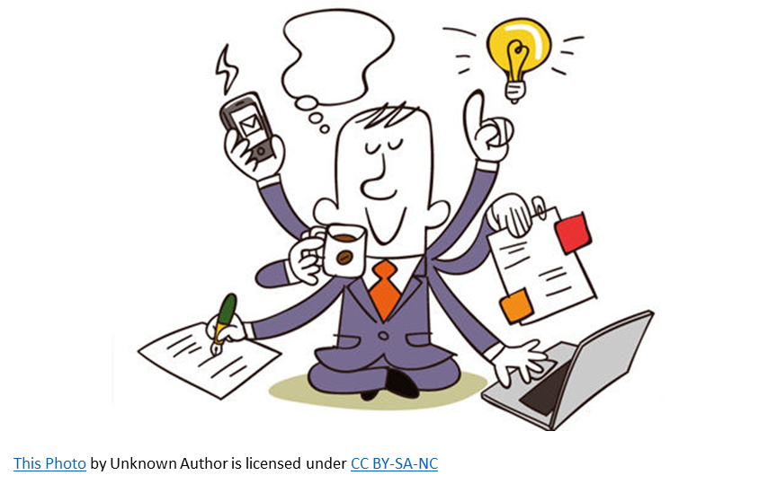
Polychronic Time
Group-based. High-context culture.
Multi-tasking is a talent.
High interpersonal values.
Time is flexible.
Schedules are loose or non-existent.
P-time patterned people are more past and present-oriented than expressing eagerness towards the future.
P-time is observed in Asian, African and Latin cultures.

Slide 10
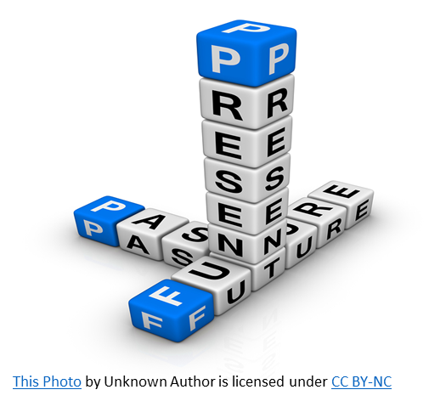
Time Orientations
Humans develop time cognitivism over the age, depending upon their culture and upbringing.
There are four different types of time orientation:
Past
Present
Future
Timeline

Slide 11
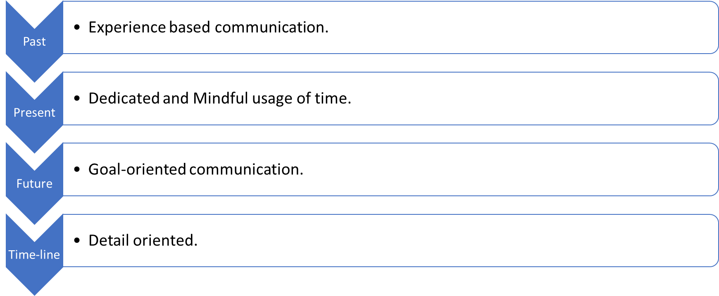
Four Types of Time Orientations

Slide 12

Time and Negotiation
Time speaks a lot, especially when it is communication between parties of different power hierarchies.
1. Waiting time
2. Talk time
3. Work Time
The parties with higher power positions shall afford to bend time as per their convenience.
The subordinate group are bound to stick to their time constraints.

Slide 13
Timing and Time-keeping
“The clock may be the machine of all the machines” (Bruneau 428)
Mumford notes that the primary characteristic of human civilization is its temporal regularity.
Time keeping allows one to keep track of things that happened and happening.
In public speaking, it becomes an integral part to stick to the time regulations.
In formal scenarios, it is observed that timekeeping:
Optimizes individual performances.
Increases clarity in communication.
Provides more accuracy without any delays or errors.

Slide 14
Speech Chronemics
The term “speech chronemics” is introduced by psychologist H.P. Krüger.
It elucidates upon time as a hidden dimension of speech.
His research work focused on analyzing speech signal patterns.
The patterns consisted of two primary distinctions:
Speaking (Ons)
Pausing (Offs)
The time taken by participants while speaking and pausing was studied in order to understand the larger effect of communication. (Krüger 11)

Slide 15
Importance of Timing in Public Speaking
A public speaker should make the most out of given time stipulations to gain successful feedback.
Time awareness – Timers are available in certain scenarios. However, wearing a watch comes in handy.
Repetitive rehearsal in accordance with the given time limit.
Time utilization is not just for speakers but also for listeners.
A speaker should allow time for listeners to react and engage with the content delivered.

Slide 16
Avoid Chronarchy
Wright pinpoints “the tyranny of clockworks” in the contemporary world.
Communication theorists like Bruneau suggest that humans should use time and not let it be another way around.
“Let chronarchy, then, be not merely ‘rule by time’, but ‘regimentation of man by time-keeping’ ” (Bruneau 428)
Objective timekeeping should be controlled. Intercultural differences in perception of time must be embraced and accommodated.

Slide 17
Time matters
Adrenalin
Subject concern
Contractual

Slide 18
Contd…
The speaker and the audience are in quite the opposite state.
Speakers are emotionally involved in what they are saying.
Timing of a speaker’s talk is a contract with the audience.
Span of memory and attention is limited.
Good timing lends security to the audience and helps the speaker reflect his competence.

Slide 19
"The entire universe is weighted toward rhythm . . . everywhere, as in a cosmic dance, natural bodies are doing their rounds . . . the universe is littered with clocks."
Dora Marsden
Thank You

Slide 20
Works Consulted
• Bruneau, Thomas J. “Chronemics: The study of time in human interaction”, Journal of the Communication Association of the Pacific, vol. 6, no. 1, 1977.
---.“Time, change, and socio-cultural communication: A chronemic perspective.” Sign Systems Studies, vol. 35, no. 1-2, 2007, pp. 89-117.
• Krüger, H.P. “Speech chronemics-a hidden dimension of speech. Theoretical background, measurement and clinical validity.”, Pharmacopsychiatry, vol. 22, no. 1, 1989, pp. 5-12.
• Lindquist, Jay D., and Carol Scarborough. “The polychronic-monochronic tendency model: PMTS scale development and validation.” Time and Society, vol. 16, no. 2, 2007, pp. 253 – 285.
• Mumford, L. Technics and civilization. Brace & World, 1962.
• Wright, Lawrence. Clockwork man. Horizon Press, 1968.
• https://www.pmi.org/learning/library/everything-time-monochronism-polychronism-orientation-6902

